Slide 1
The Mind And Its Control
Book By Swami Budhananda

Slide 2
Team Members
Yash Mohite V61
Kedar Phutane V65
Krrish Joshi V64
Ashwin Gerela V63
Divya Nalakakula V66
Shivani Mayekar V67

Slide 3
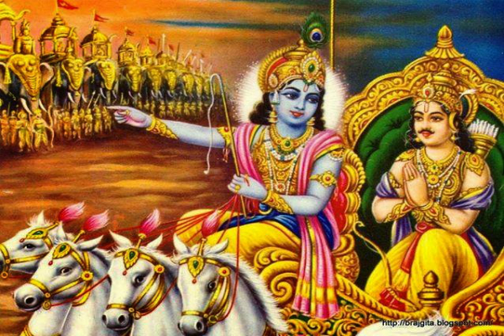
Mind Control is difficult but possible

Slide 4
How to strengthen the will to control the mind
What is at stake in controlling the mind
Our will to control the mind can never be strong until and unless we have deliberately and renounced pleasure as one of our main pursuits of life.
If one mam conquers the battle a thousand men a thousand times, and if another conquers himself he is the greater conquer.
A person of controlled mind will be free from mental maladies and physical troubles caused by mental tension.
Once we really understand and believe this, our will to control the mind will become strong, as strong as we need to have it.

Slide 5
How to overcome the pleasure
motive
The nature of the mind
Hindi view
We must not however complicate our inner situation by imagining that we are wicked in seeking pleasure.
The pleasure motive is not in itself though of course indulgence is immoral pleasures which creates which creates greater bondage.
Behind the man is Atman , the real self of man. Body and mind are material ; Atman is pure spirit.
According to the Hindu analysis the mind has three constituents three level, four functions and five conditions.

Slide 6
A favourable inner climate need to be created
The clear grasp of the task on
hand needed
It must be clearly understood and fully accepted that there is no gimmick by which the mind can be controlled. Looking the mind, a delicate instrument, should be handled very carefully.
The mind has to be gradually and systematically brought under control and needs a lot patience
To control the mind we need to create a favourable inner climate where concisely accepting certain inevitable of life and creates a positive attitude towards work
e.g. the five things we worry about most is that is old age, disease, death, decay, whatever the outcome is of my own deeds

Slide 7
The purer the mind the easier to control the mind
Changing the constitution of
the mind
The control of the mind depends upon purity more the purer the easier to control it.
We should practice discipline for the purification of the mind and remove the impurities of the mind like anger, fear, guilt, etc.
The important part of the controlling mind also depends on the foods and drinking habits of one.
Our mind is the most subtle part of the mind just as curd churned and transformed to make the butter.

Slide 8
Two sets of inner
discipline
Holy company greatly helps in the mind control
In the first set several basic disciplines are included like there should be a proper routing for daily life and certain basic principle by which a sense of direction is given to whatever we do without which it is impossible.
In the second we must check we must check its proverbial restlessness and its causes in the mind.
When we are in the company of the perfected soul the powerful vibrations act as a catalyst and helps in speedy change in the Guna (pure) composition of mind Thus, resulted in the sattva dominance of the mind and easier to control the mind .
And some time not possible we should depend on our resources that is suitable for us while controlling the mind .

Slide 9
How is sattva purified
and how
Basic yoga discipline for mind control
The purification of sattva takes place through constant discrimination between real and unreal.
One should progress in spiritual life and various mediums to attain the same with great focus on leading a sattvic life.
One should do yoga everyday in order to control their mind.
Yoga discipline helps in undisturbed calmness of mind by following ways: -
Friendliness towards the happy
Compassion for unhappy
Delight in good

Slide 10
Practice of discrimination
helps
Training the mind to
behave
We do some things deliberately knowing that is the right thing to do, in some cases, we act impulsively without knowing what is right & wrong.
We should learn how to discriminate between right and wrong, real and unreal, etc.
One should train their minds in such a way that it also trains our mind how to behave.
We must let go our false identification of self and have a firm and calm mind.
We should be happy in other’s happiness.

Slide 11
Practice of pranayama
Practice of pratyahara
Regular practice of deep breathing helps to develop a stable state of mind.
Pranayama should be learnt in a clean atmosphere.
By doing pranayama daily our mind gets relaxed and calm.
Pratyahara calms the mind, slows mental stimulation, etc.
Things should not focus our mind .
Until we learn to do pratyahara nothing is practically achieved by way of controlling the mind .

Slide 12
Importance of harmonious
human relations
Healthy occupation of
mind needed
Those who wants to their mind must not store up ill feelings.
A healthy mind is much easier to control than an unhealthy or broken mind.
The common says ‘an idle brain is the devil's workshop’ is very true.
Buddhist Teachings – As a fletcher makes straight his arrow, a wise man makes straight his trembling and unsteady thought, which is difficult to guard, difficult to hold back. Let the wise man guard his thoughts, for the are difficult to perceive, very artful and they rush wherever they listed; thoughts well-guarded bring happiness.

Slide 13
Importance of
meditation
Importance of right use
of imagination
Our expectations may be imaginary, without any basis in fact, but they bring us real disappointments.
It extremely difficult to control the mind. How do we do it?
Meditation and control of the mind go hand in hand.
So, when once a disciple asked Swami Brahmadanda, 'Maharaj, how can one control the mind?' the teacher, in effect, explained how the above instruction was to be. put into practice. He said: Through gradual practice the mind has to be concentrated upon God.

Slide 14
Guard and despondency
Directed Thoughts
These are the basic disciplines.
We must not allow the despondency to eat into our earnestness and energy .
Shri Ramakrishna Teaches – All the sins of the body fly away if one chants the name of God and sings His glories. The birds of sin dwell in the tree of the body.
What the non-believer should try to do in an emergency.

Slide 15
Control of thought - The secret
Control of the subconscious mind
Discipline which can take care of the conscious level of mind.
As long as we identify ourselves with the ego or the body we cannot reach this stage.
Repetition of GAYATRI MANTRA & OM greatly helps to control our mind.
Importance of controlling the conscious mind.
Awakening of kundalini thought the raja yoga method of Pranayama.
Practice of spiritual disciplines.

Slide 16
Beware of a trick of
the mind
Believers are at an advantage in controlling the mind
As Meister Eckhart the German mystic says: In the heart of this moment is eternity.
The future is nothing but MAYA.
When faith in god is sincerely cultivated we get potent help for controlling the mind.
When lust, anger, and other passions disappear the mind becomes purified.

Slide 17
The simplest and the surest method of controlling the mind
The same truth comes to us equally forcefully from holy mother’s life
Methods of controlling the mind.
Sri Ramakrishna teaches: The best thing for people whose minds are attracted by sense objects is to cultivate the dualistic attitude and chant loudly the name of the lord as enjoyed in the NARADA PANCARATRA.
Why do I not succeed?
How to control mind?

Slide 18
Summary
We are what our Thoughts made us; so, take care what you think.
We must learn Learn How to Manufacture Good Thoughts.
One Moment of Company with the Holy makes a Ship to cross The Ocean of Life.
It is Foolishness to Worry about The Future while Allowing the Devil to Conquer the Present.
A Pure Mind Is Easily Controlled.
Mind Control is Greatly Helped by the practice of Mediation, and Mediation by Mind Control.
Believers are at an advantage in Controlling the Mind.
A pure and Stable mind Enables to See Things Clearly.
Mind Control is greatly helped by the practice of Mediation, Mediation and Mediation.
Constant Pouring of Positive Thoughts Cleans the Subconscious Mind.
Mind controlled is valuable because it leads to the highest blessing.

